Slide 1

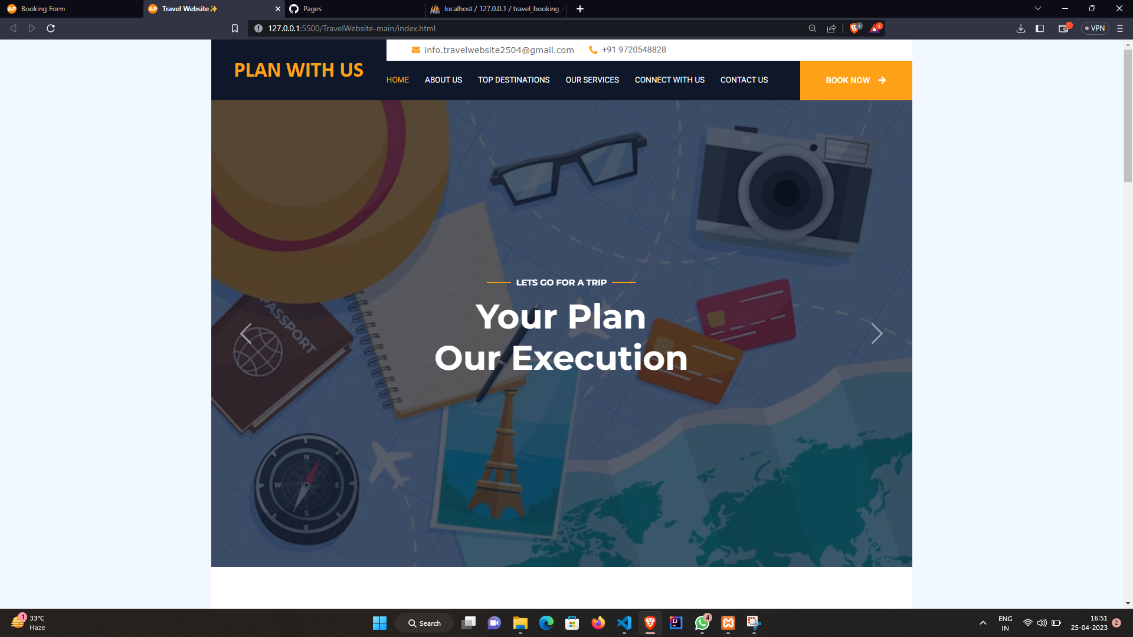
MINI PROJECT - II
https://aakrati442.github.io/TravelWebsite/

Slide 2
LANGUAGES USED
HTML – HTML stands for Hypertext Markup Language. It is used for creating web pages and web applications.
CSS - CSS stands for Cascading Style Sheets. It is a style sheet language which is used to describe the look and formatting of a document written in markup language.
JavaScript - It is a scripting language used to create and control dynamic website content, i.e. anything that moves, refreshes, etc.

Slide 3
LANGUAGES USED
Bootstrap – It is a collection of HTML, CSS and JavaScript tools used for creating and building web pages and web applications.
Google Firebase - Firebase is an app development platform that helps you build and grow apps and games users love. Backed by Google and trusted by millions of businesses around the world.
PHP - PHP(short for Hypertext PreProcessor) is the most widely used open source and general purpose server-side scripting language used mainly in web development to create dynamic websites and applications.

Slide 4
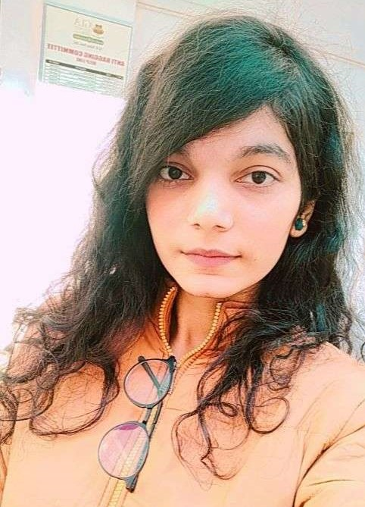
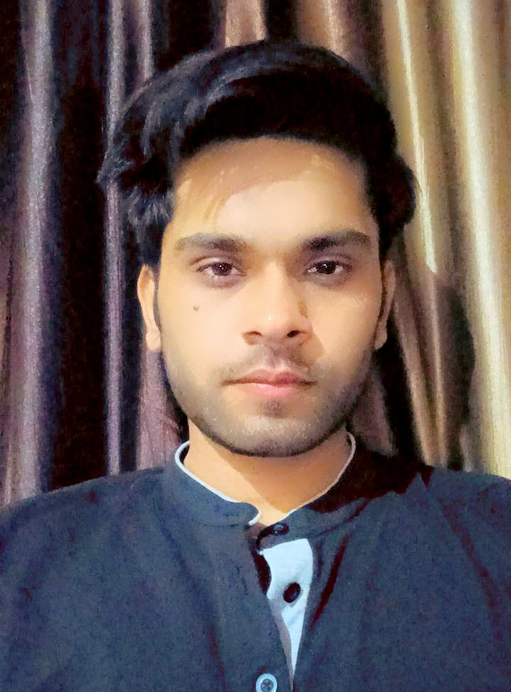
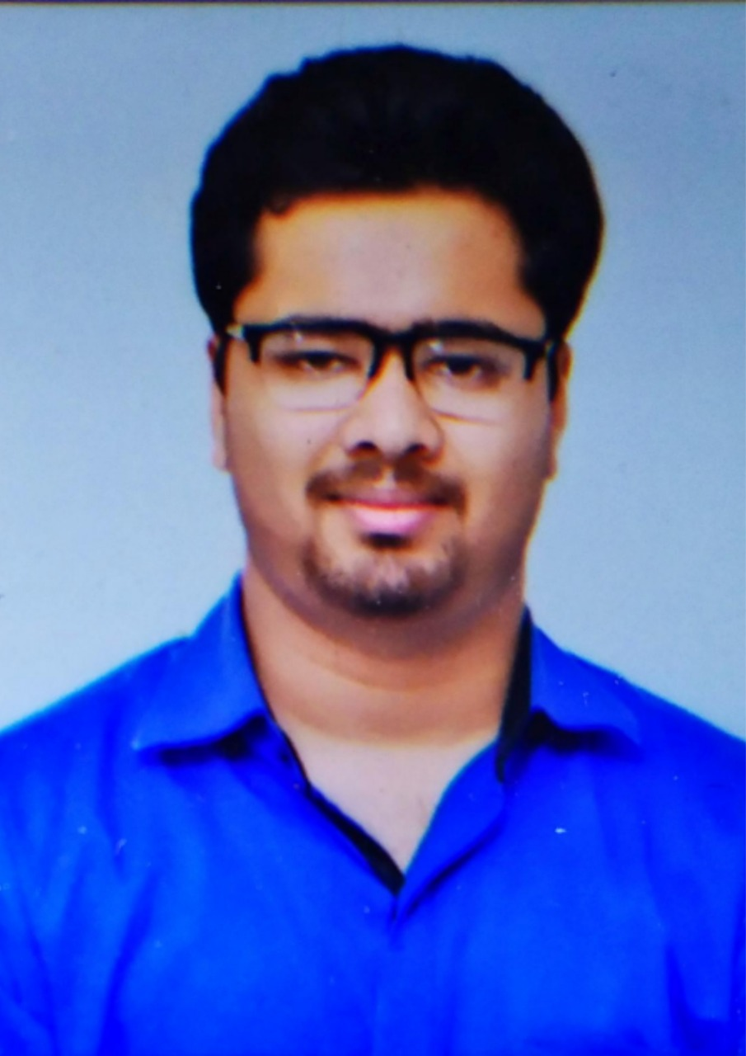
TEAM MEMBERS
Aakrati Gupta 201500001
Prashant Kumar Upadhyay 201500505
Yash Agrawal 201500810

Slide 5
HOME PAGE
Have A Look At Our Home Page Which Definitely Gives You an Overview of Website features

Slide 6
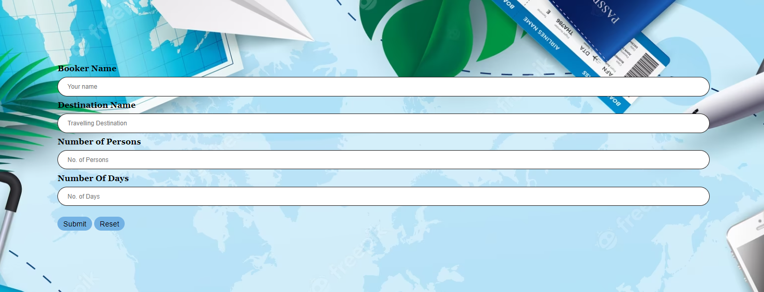
BOOK NOW PAGE
Helps you in Booking Your Favourite Destination with all details which will be stored in the PHP database

Slide 7
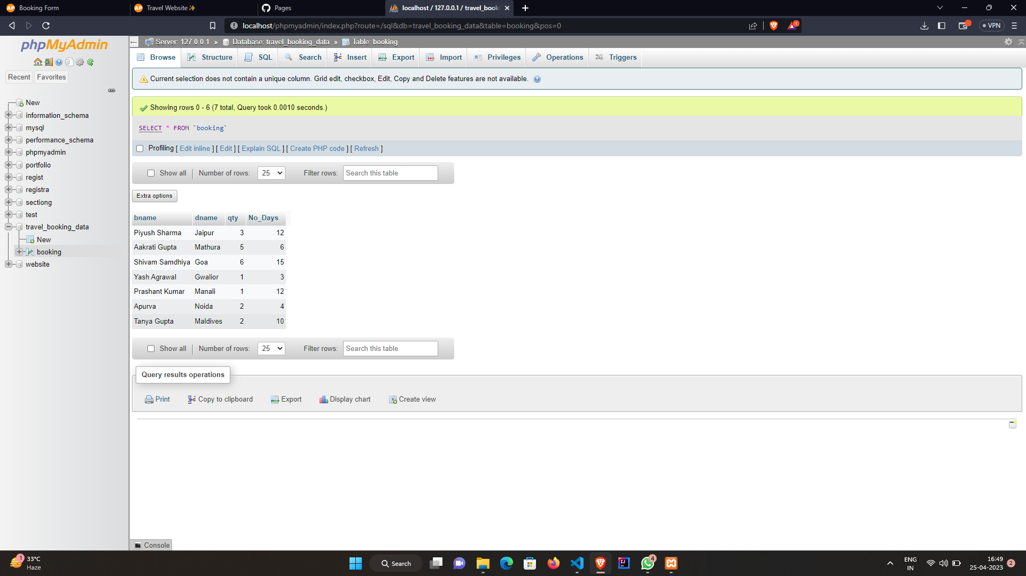
PHP DATABASE
Your Booking Details will be stored here at our PHP Database

Slide 8
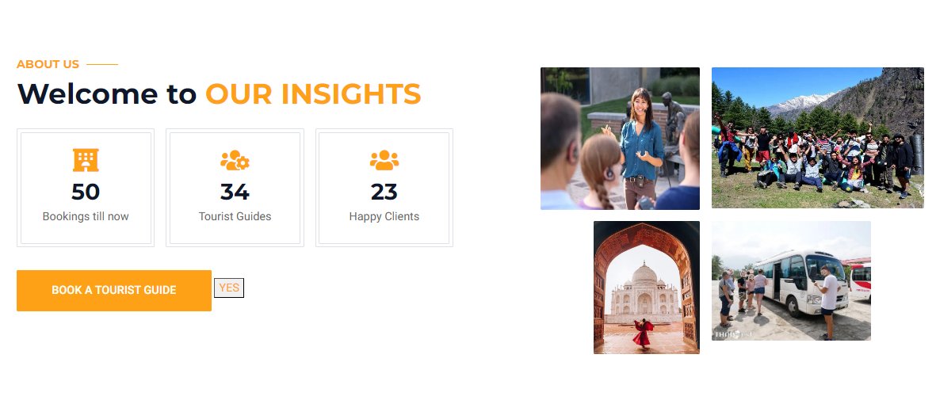
ABOUT US PAGE
Gives you a glimpse of the insight features of our website along with an option of Book a Tourist Guide

Slide 9
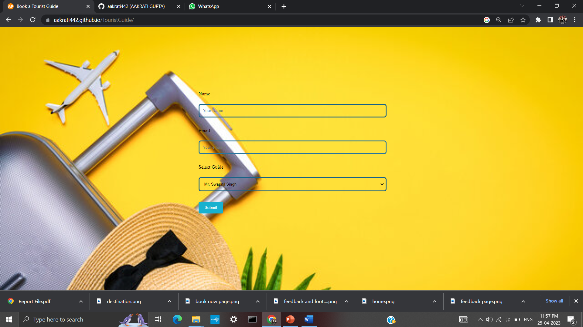
BOOK A TOURIST GUIDE PAGE
Helps you in Booking your preferred Guide with a list of Guides

Slide 10
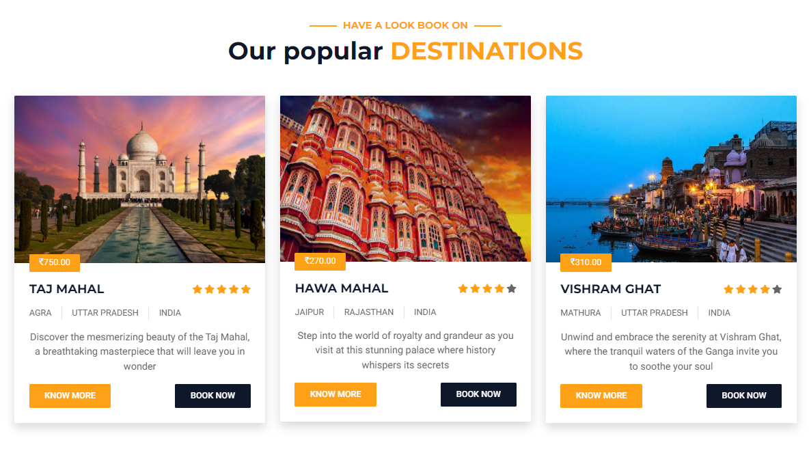
OUR POPULAR DESTINATIONS
It’s time to have a look at our most preferred destinations along with their ratings, history, and option to book them

Slide 11
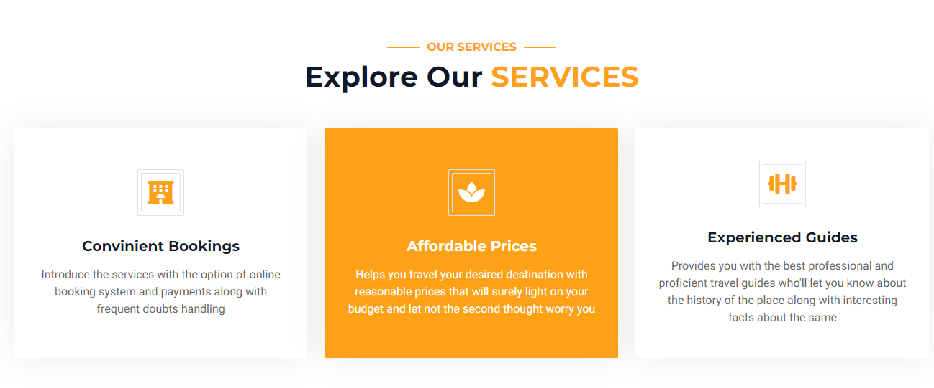
OUR SERVICES
Our services will definitely convince you to choose us
https://chaturvediishika.github.io/Tic-Tac-Toe/

Slide 12
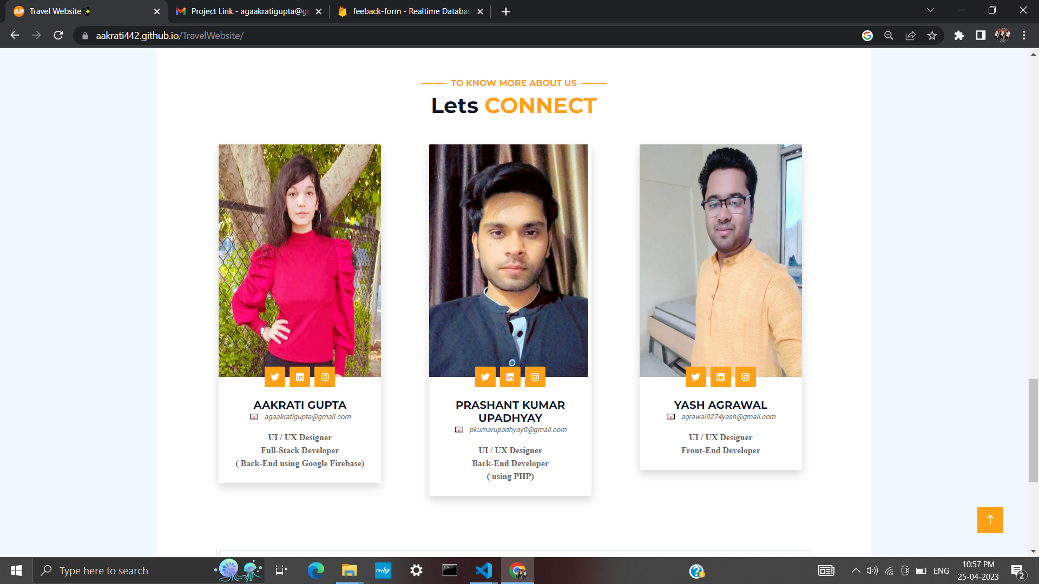
OUR TEAM
It contains information about the website designers and developers along with their roles
and social media handles
https://chaturvediishika.github.io/Tic-Tac-Toe/

Slide 13
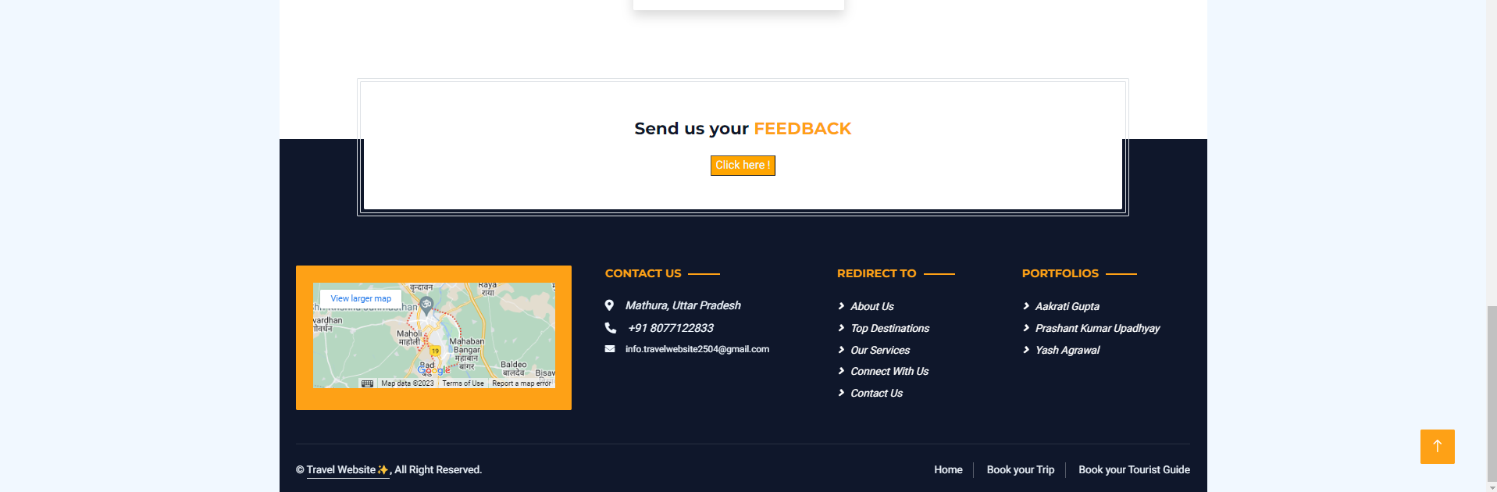
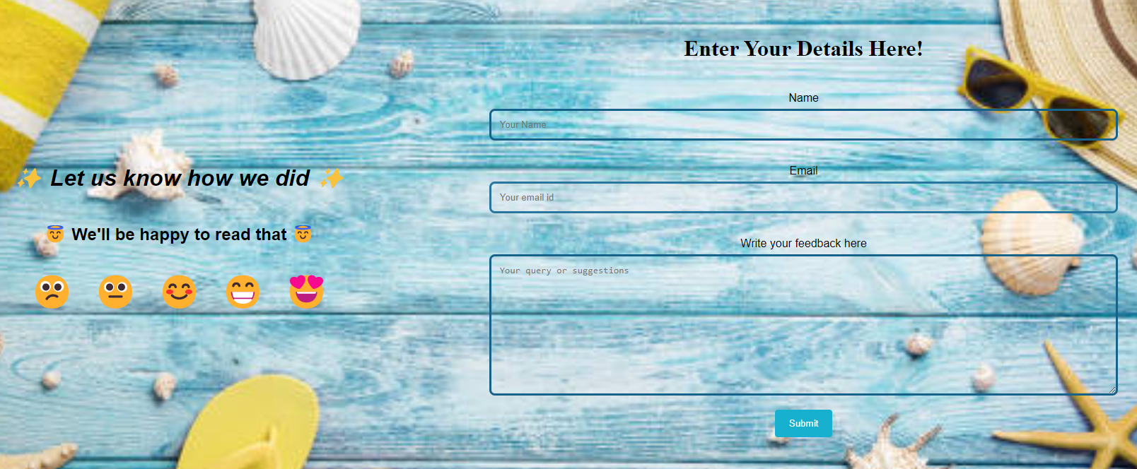
FEEDBACK PAGE
Your valuable feedback will let us know how we did which will get stored in the Google Firebase

Slide 14
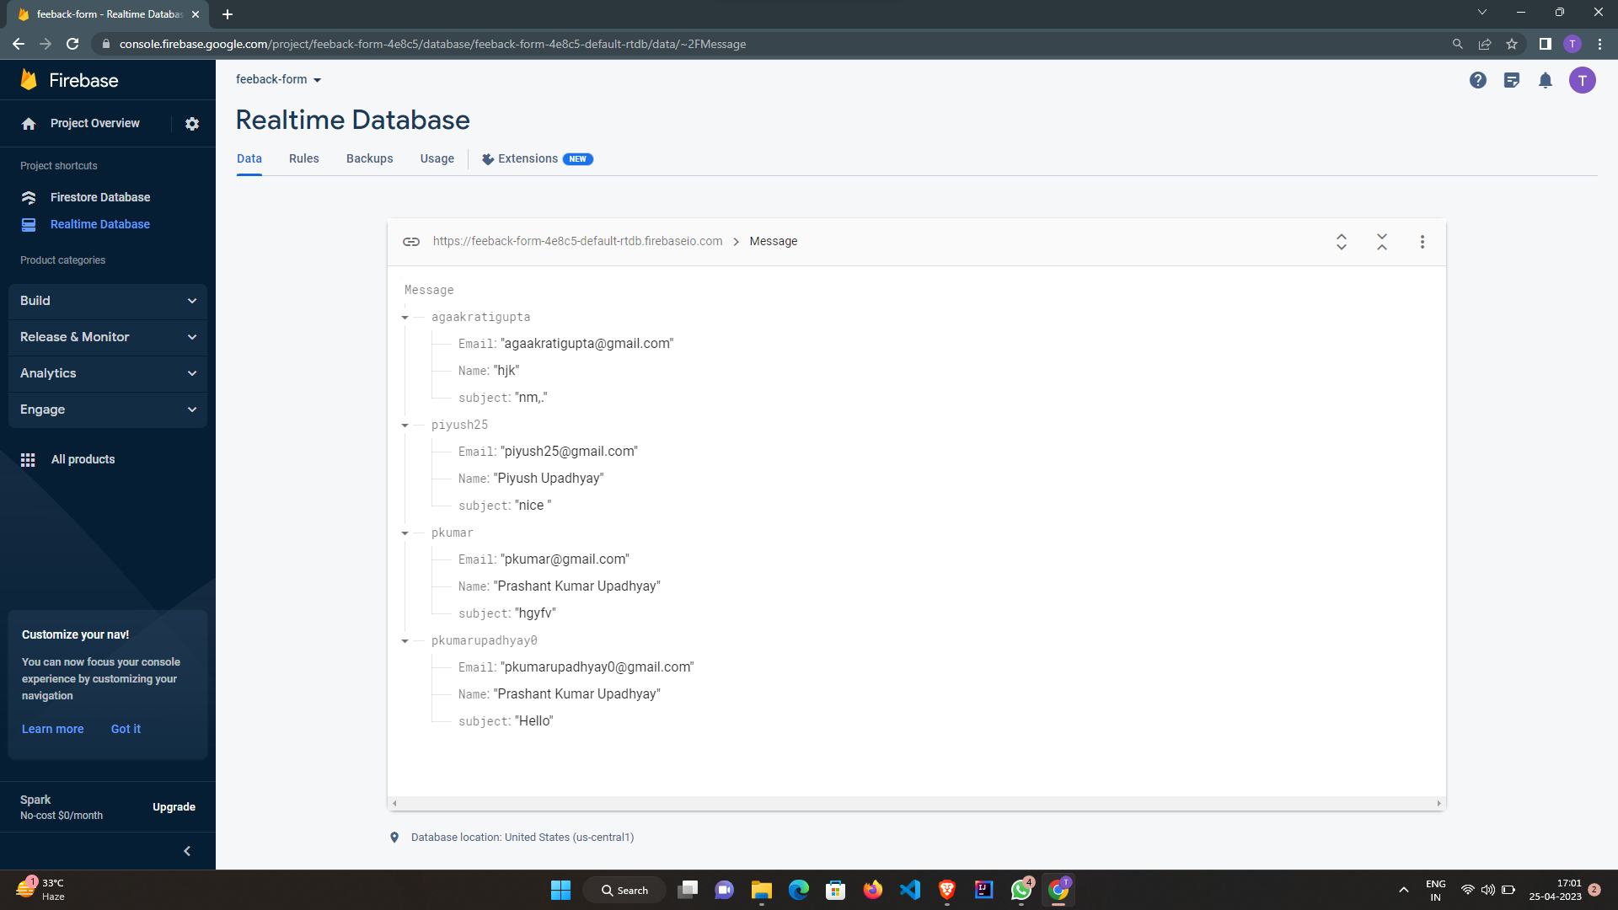
GOOGLE FIREBASE
All your feedbacks will be tracked by using Google Firebase

Slide 15
FOOTER SECTION
Last but not least, the short summary of the overall website along with the address, important
links, copyright, and the portfolios of the developers

Slide 16
THANK YOU
We are waiting to receive your valuable feedback

